Slide 1
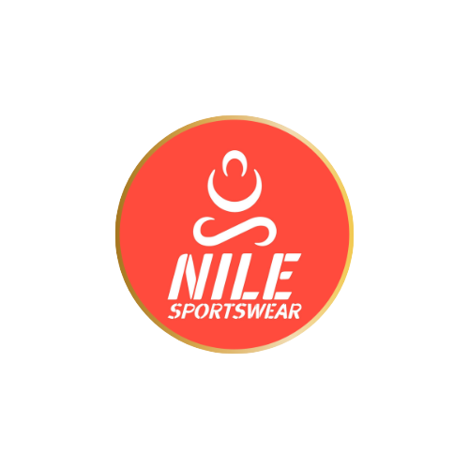
Nile Sportswear Business Plan
Move with confidence

Slide 2
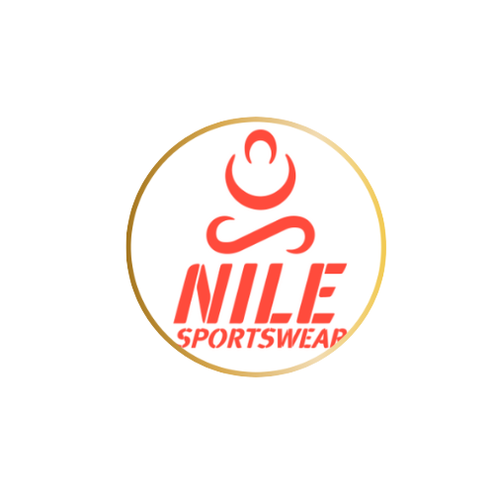
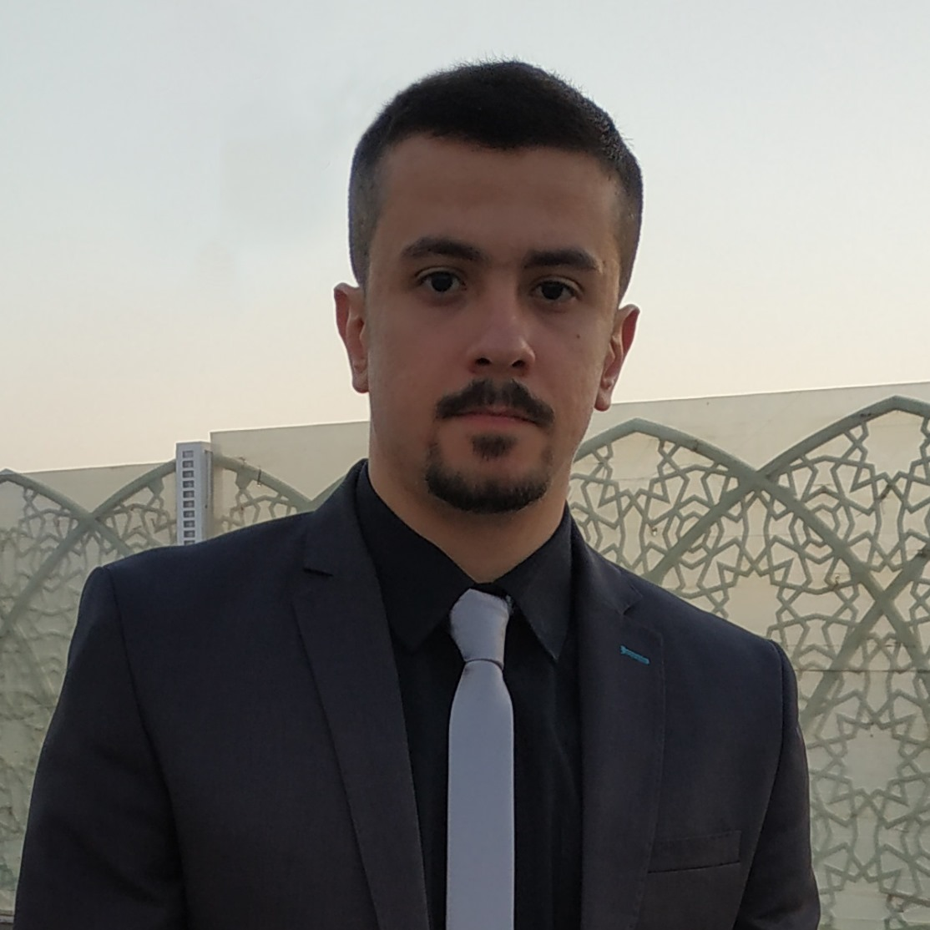
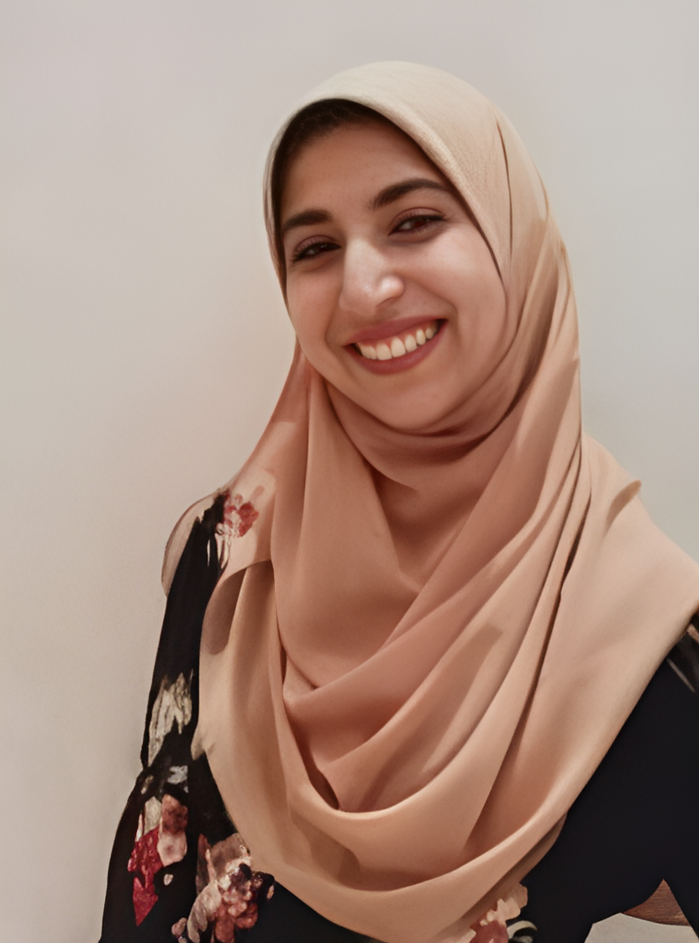
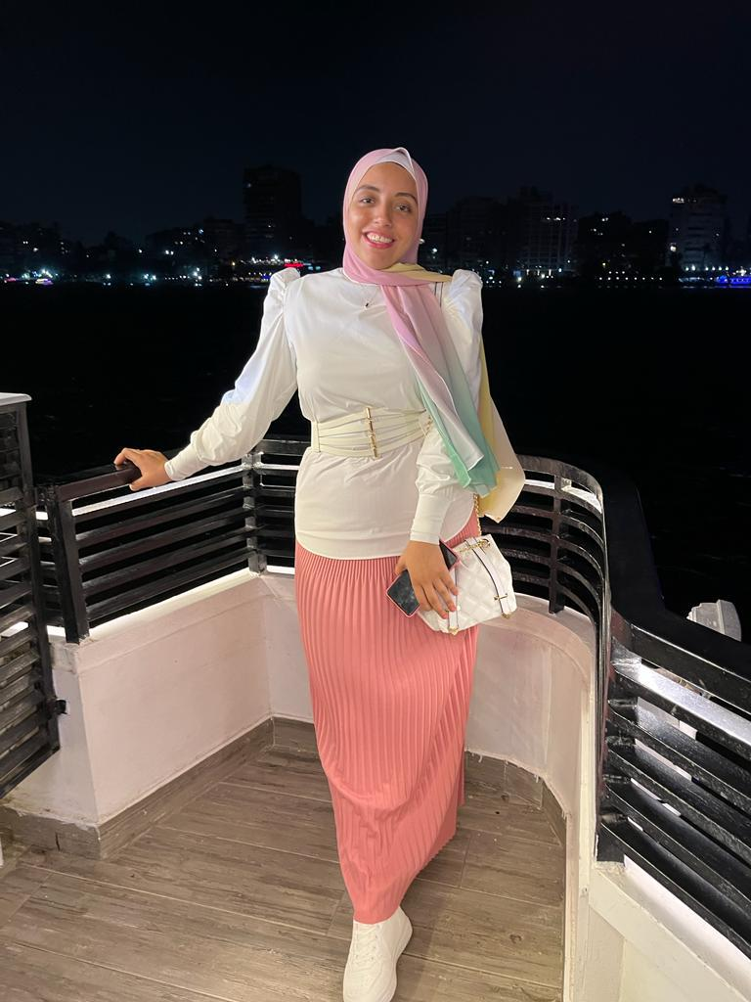
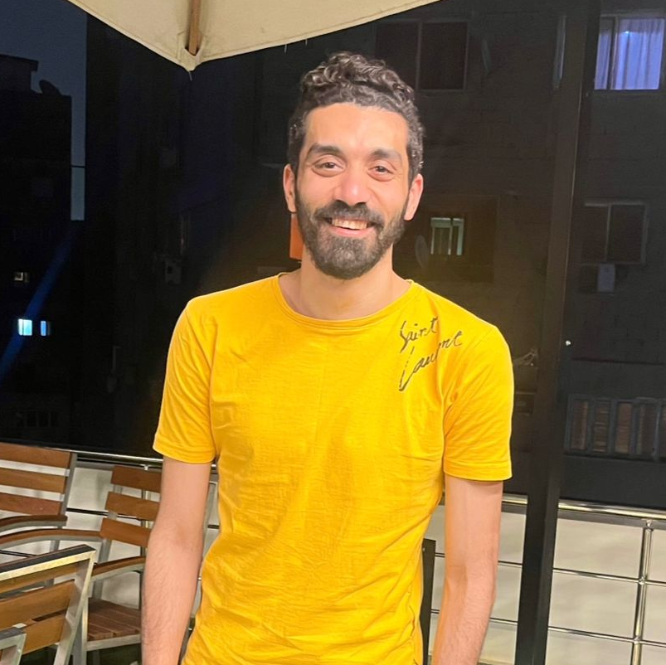
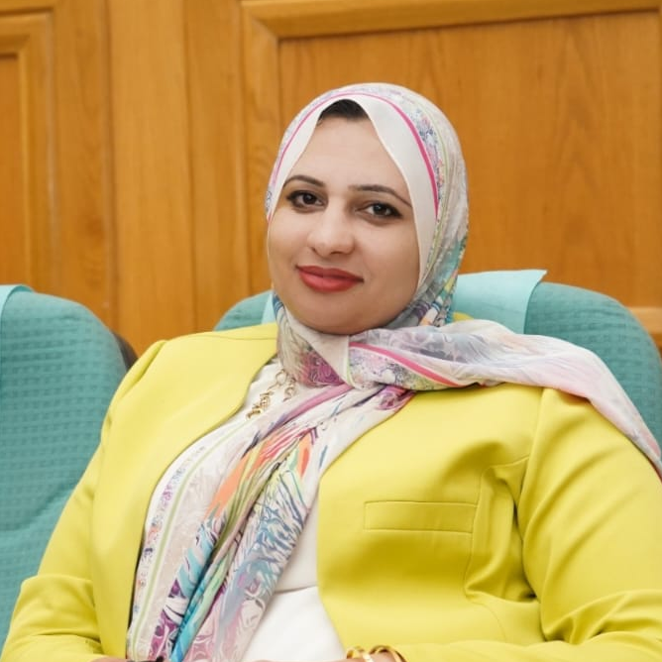
The marketers
Ahmed Abdelkader
Doaa Ahmed
Lina Hamed
Sherif Belal
Safaa Wasef

Slide 3
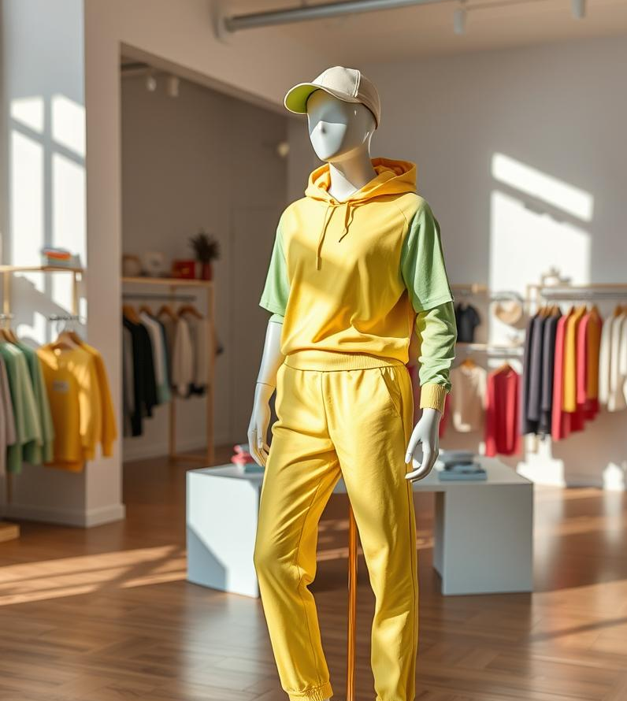
Business Model
Canvas
Business Model Canvas

Slide 4
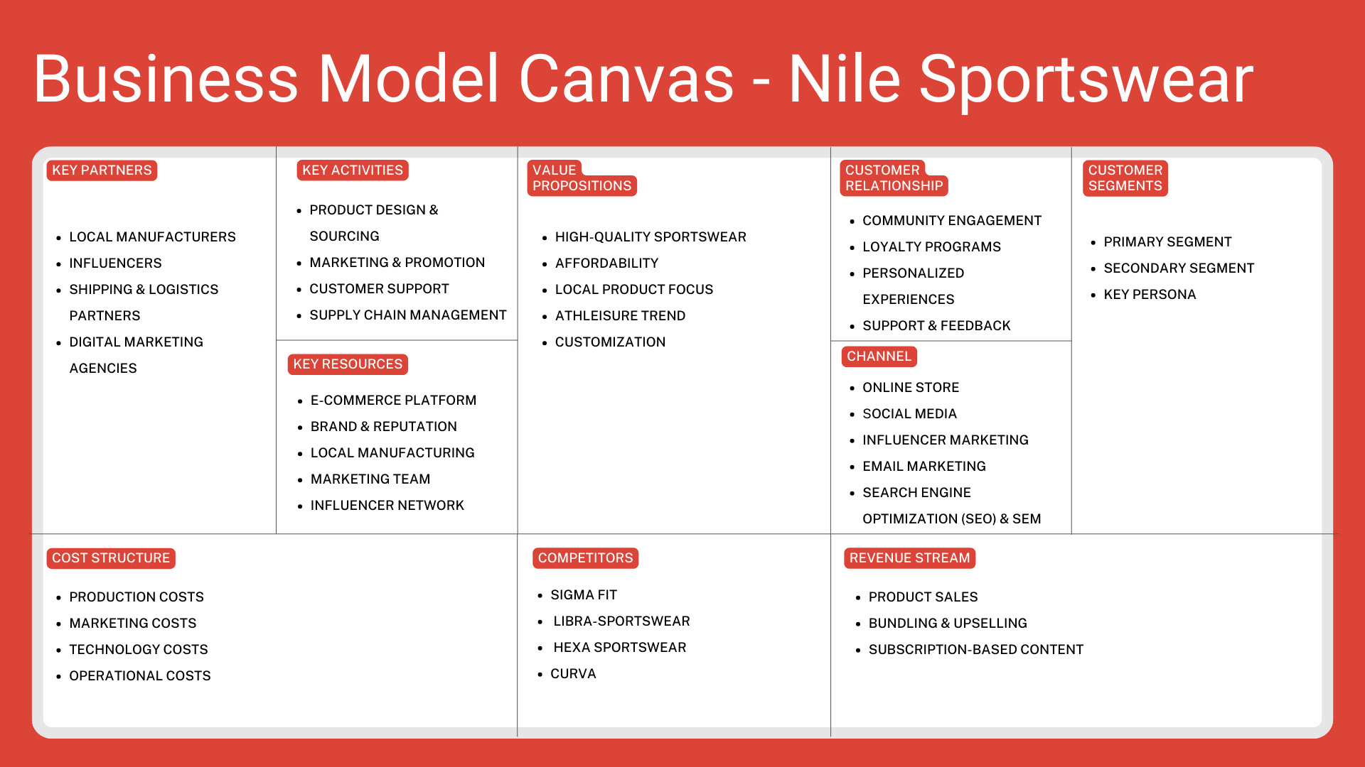

Slide 5

Situational analysis
We did an internal and external analysis, which resulted in SWOT.

Slide 6
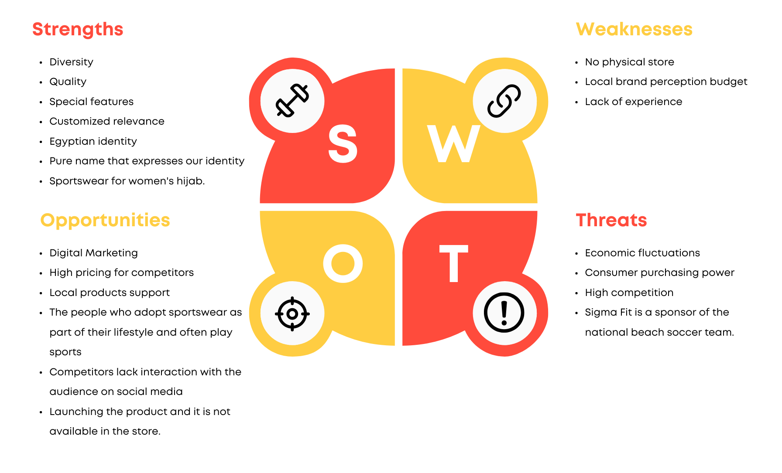
o
T

Slide 7
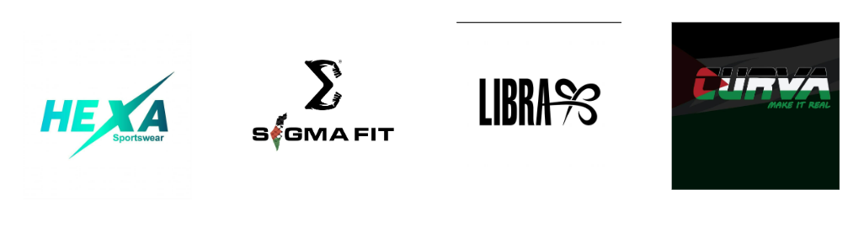
Competitors

Slide 8



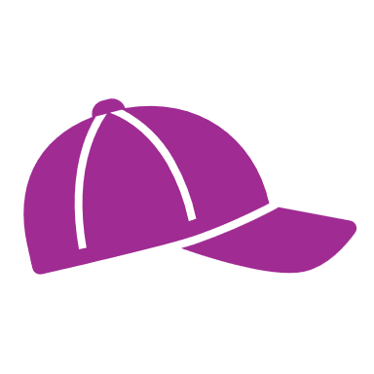
1. Increase Brand Awareness (Reach 1,000 subscribers in the first month)
Objectives
2. Lead Generation (Offer eBooks, contests)
3. Customer Loyalty (Rewards program, personalized recommendations)
4. Upselling (Bundling products, recommending accessories during checkout)

Slide 9
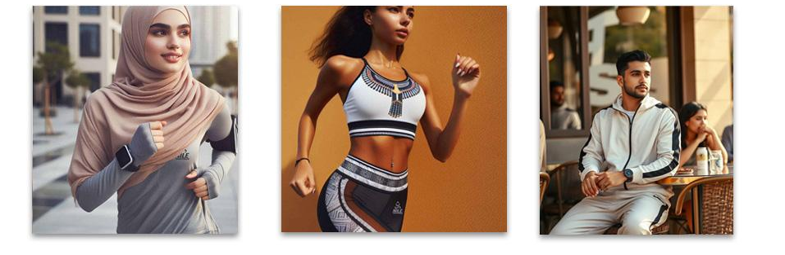
Strategy: Targeting & Buyer Persona
Yasmin
Ahmed
Sara

Slide 10
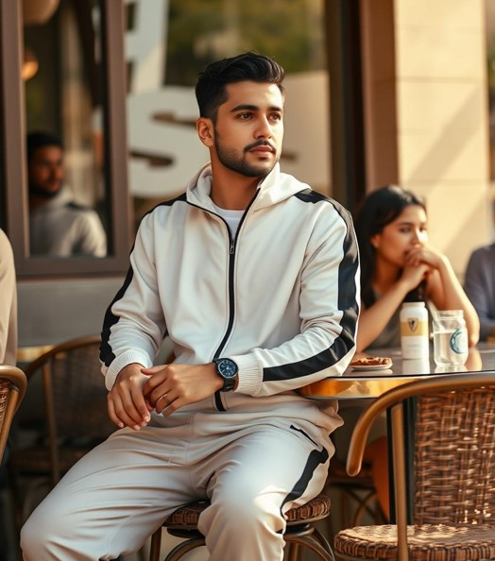
Male
•Goals: To stay in good physical shape, build muscle, and improve endurance.
•Looking for comfortable, durable, and stylish sportswear that suits both gym sessions and casual outings.
•Prefers clothes that offer flexibility and breathability, especially during intense workouts.
•Challenges:
•Finds it difficult to find affordable, high-quality sportswear that meets his fitness needs.
•Frustrated by the high prices of global brands.
•Wants to discover local brands that offer competitive quality at reasonable prices.
•Favorite Brands: Nike, Adidas, Sigma Fit, Hexa Sportswear.
•Location: Giza, Egypt
•Occupation: Software Developer at a tech company
•Income: 15,000 EGP/month
•Education: Bachelor's degree in Computer Science
•Lifestyle: Active lifestyle with a balance between work and fitness.
•Goes to the gym 4-5 times a week and enjoys outdoor sports like football and running.
•Cares about both functionality and appearance in sportswear.
•Hobbies: Gym workouts, running, playing football with friends, and following football leagues.
•Regularly watches sports events and participates in fitness challenges.
•Keeps up with the latest fitness trends and frequently shops for new sports gear.
Ahmed Ali
28 years old

Slide 11
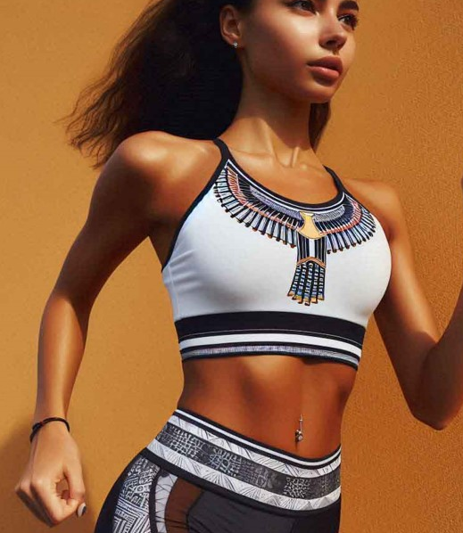
Female
•Goals:
•To stay fit and active while looking stylish in her workout gear.
•To find sportswear that transitions easily from the gym to casual day-to-day wear (athleisure).
•Wants clothing that supports her active lifestyle but also keeps her fashion-forward.
•Challenges:
•Limited time for shopping due to a busy work schedule.
•Frustrated by the high prices of international sportswear brands.
•Needs durable and comfortable sportswear that also looks good.
•Favorite Brands: Nike, Adidas, Sigma Fit, and Curva.
Location: Cairo, Egypt
•Occupation: Marketing Specialist at a tech company
•Income: 12,000 EGP/month
•Education: Bachelor's degree in Business Administration
•Lifestyle:
•Active and health-conscious, enjoys attending fitness classes, going to the gym, and running.
•Follows a balanced lifestyle, blending work with fitness and social activities.
•Spends weekends at outdoor events or sports activities.
•Hobbies:
•Running, gym workouts, yoga, and attending fitness events.
•Frequently shops for trendy, functional sportswear that fits into her busy lifestyle.
•Active on social media (Instagram, TikTok), follows fitness influencers for workout inspiration.
Sara
30 years old

Slide 12
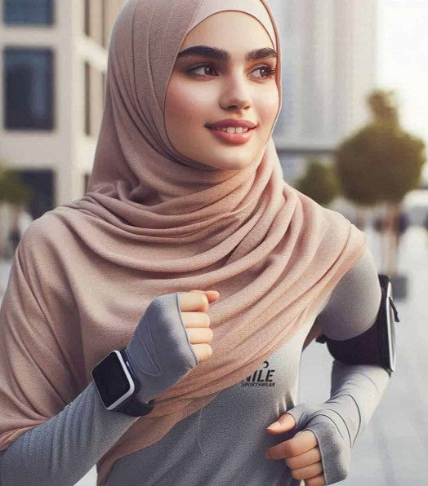
Female
•Goals:
•To stay fit and healthy without compromising on modesty.
•Looking for sportswear that is both comfortable and appropriate for her lifestyle, including hijab-friendly workout clothing.
•Wants to feel confident and comfortable during workouts.
•Challenges:
•Finding sportswear that offers both modesty and functionality.
•Limited selection of hijab-friendly sportswear from international brands.
•High prices of imported modest sportswear brands.
•Favorite Brands: Nike Pro Hijab, Hexa Sportswear, and local hijab-friendly brands.
Location: Alexandria, Egypt
•Occupation: Teacher
•Income: 15,000 EGP/month
•Education: Master's degree in Education
•Lifestyle:
•Very health-conscious and committed to fitness, regularly attending women-only gym sessions.
•Enjoys outdoor activities like walking and swimming in her free time.
•Prefers modest yet functional sportswear that aligns with her values and comfort.
•Hobbies:
•Swimming, yoga, walking, and fitness classes.
•Follows influencers who share modest fashion and fitness tips.
•Enjoys spending time with family and participating in local fitness events.
Yasmin
27 years old

Slide 13
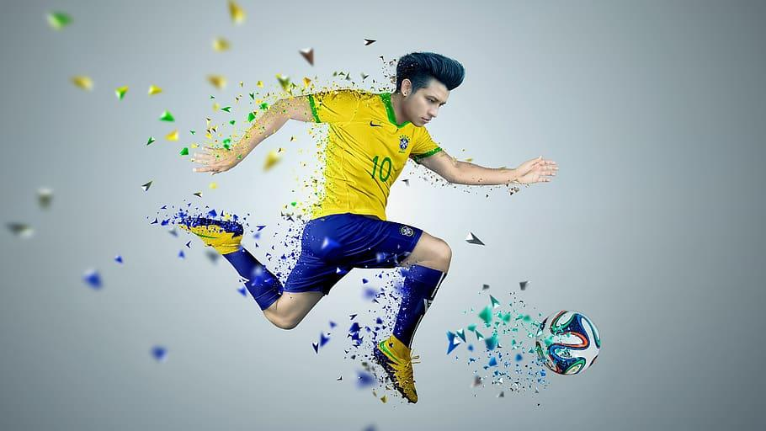
Strategy: Positioning
Sara
High-quality yet affordable sportswear for fitness enthusiasts.
Stylish, durable, local products meeting international standards.

Slide 14




Tactics (4Ps)
PRODUCT: WIDE RANGE OF SPORTSWEAR, INCLUDING SPORT-SPECIFIC CLOTHING.
PRICE: COMPETITIVE PRICING STRATEGY, T-SHIRT (350-500), SPORT SUIT (800-1000).
PLACE: ONLINE STORE WITH USER-FRIENDLY INTERFACE.
Promotion: social media, SEO, influencer collaborations.

Slide 15
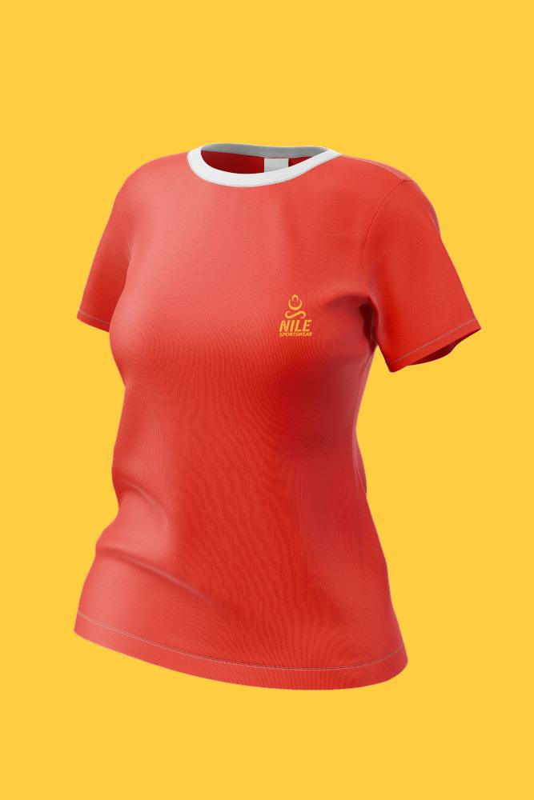
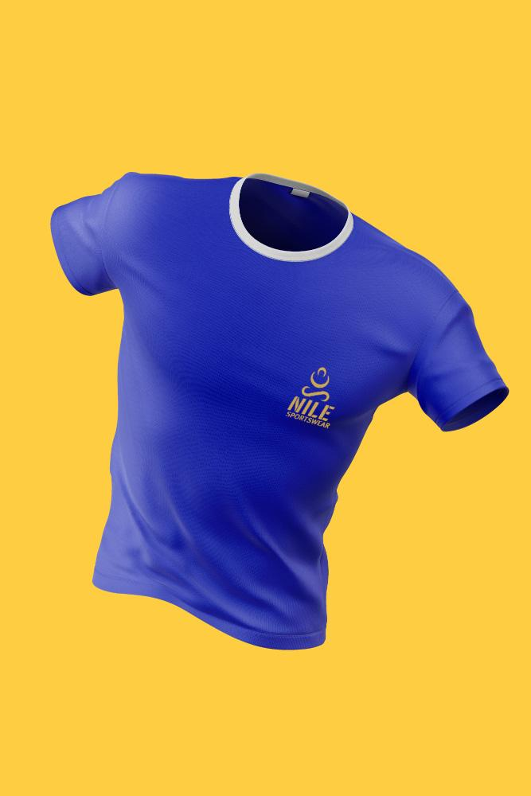
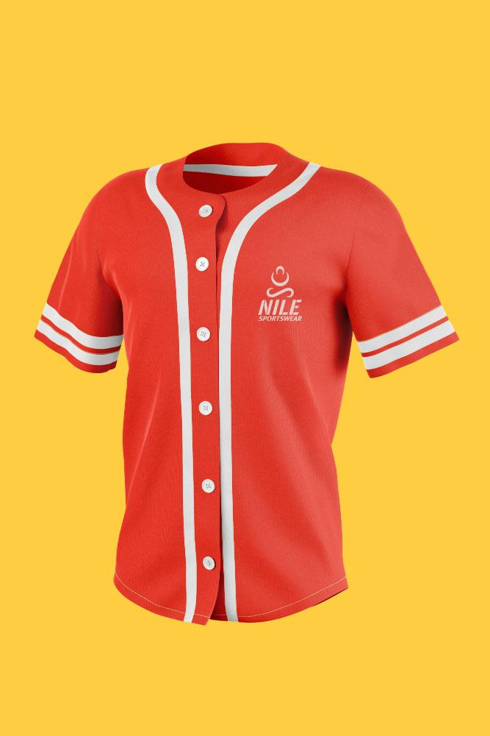
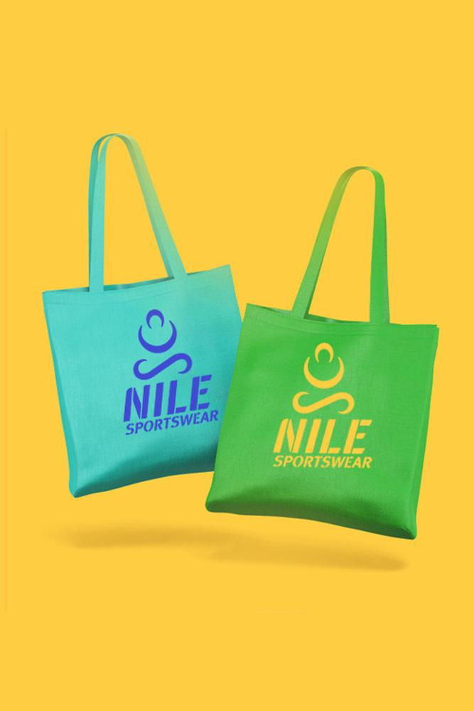
Products

Slide 16
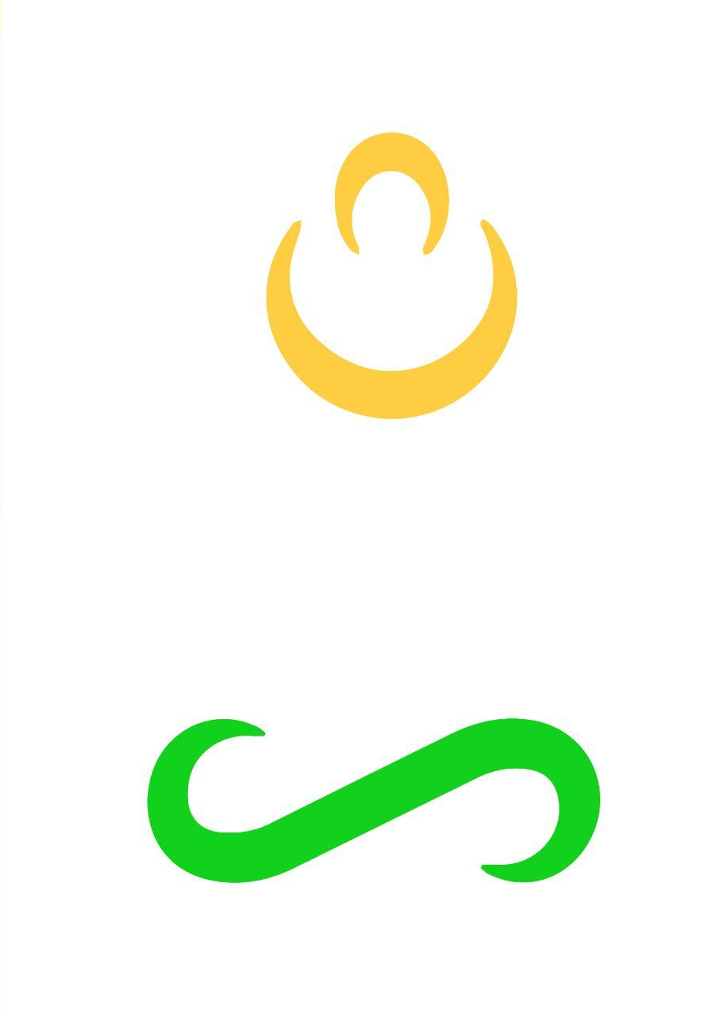
Products
The symbol resembles a stylized human figure in a running pose.
The wave-like element symbolizes the nile river, a significant part of the egyptian identity and culture

Slide 17
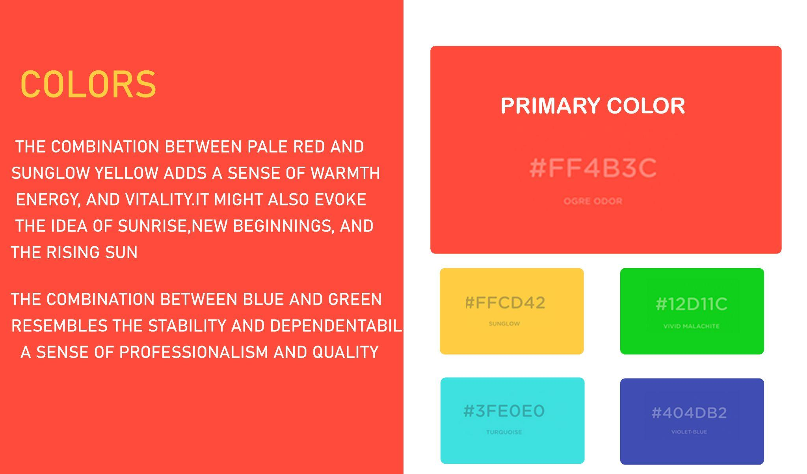
Colors

Slide 18
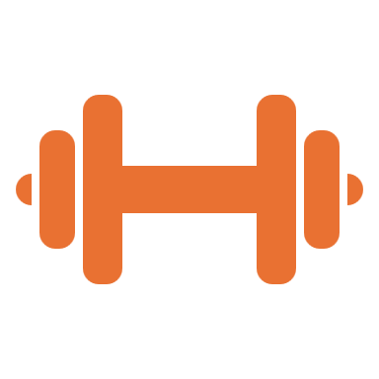




Educational Content: Fitness tips, workout routines.
Content Strategy
Product Demos: Highlighting breathability, flexibility, style.
User-Generated Content: Customer fitness journeys.
Influencer Collaborations: Featuring fitness influencers.
Promotions: Special offers, discounts.

Slide 19





Platforms
Social Media Platforms:
FACEBOOK
INSTAGRAM
TIKTOK
GOOGLE SITES
EMAIL MARKETING

Slide 20
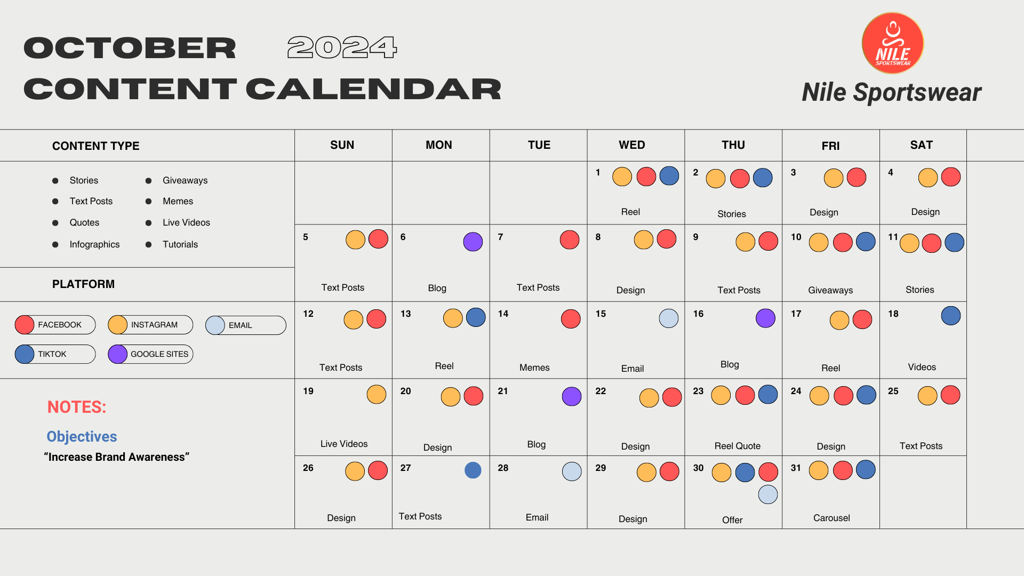
o
T

Slide 21
Action: First four-month period
Action Area | Deadline | Budget (EGP) | Expected Outcome
1. Social Media Advertising | Ongoing | 20,000 EGP | Increase brand awareness, grow followers to 5,000, drive website traffic, and boost social media engagement.
2. Influencer Partnerships | Monthly | 20,000 EGP | Generate brand visibility, increase trust among target audiences, and drive traffic and sales from influencer recommendations.

Slide 22
Action
Action Area | Deadline | Budget (EGP) | Expected Outcome
3. SEO & Website Optimization | Ongoing | 10,000 EGP | Improve website ranking for sportswear-related keywords, leading to a 10% increase in organic traffic over 6 months.
4. Email Marketing Campaigns | Monthly | 5,000 EGP | Grow the email list to 2,000 leads; increase email open rates and conversion rates, leading to better customer engagement.

Slide 23
Action
Action Area | Description | Budget (EGP) | Expected Outcome
5. Loyalty Program Expansion | Monthly | 5,000 EGP | Increase customer retention by 30-40%, achieve higher repeat purchase rates, and improve overall customer satisfaction.
6. Content Creation (Videos & Graphics) | Monthly | 7,000 EGP | Engage the audience with top-quality content, leading to higher social media interaction, better brand positioning, and increased sales.

Slide 24
Action
Action Area | Description | Budget (EGP) | Expected Outcome
7. Promotions & Discounts | Monthly | 5,000 EGP | - Boost overall sales, increase average order value (AOV), and attract new customers with competitive pricing during campaigns.
8. Google Ads Campaigns | Monthly | 5,000 EGP | - Attract high-intent buyers, increase website traffic from Google searches, resulting in higher online sales and leads.

Slide 25
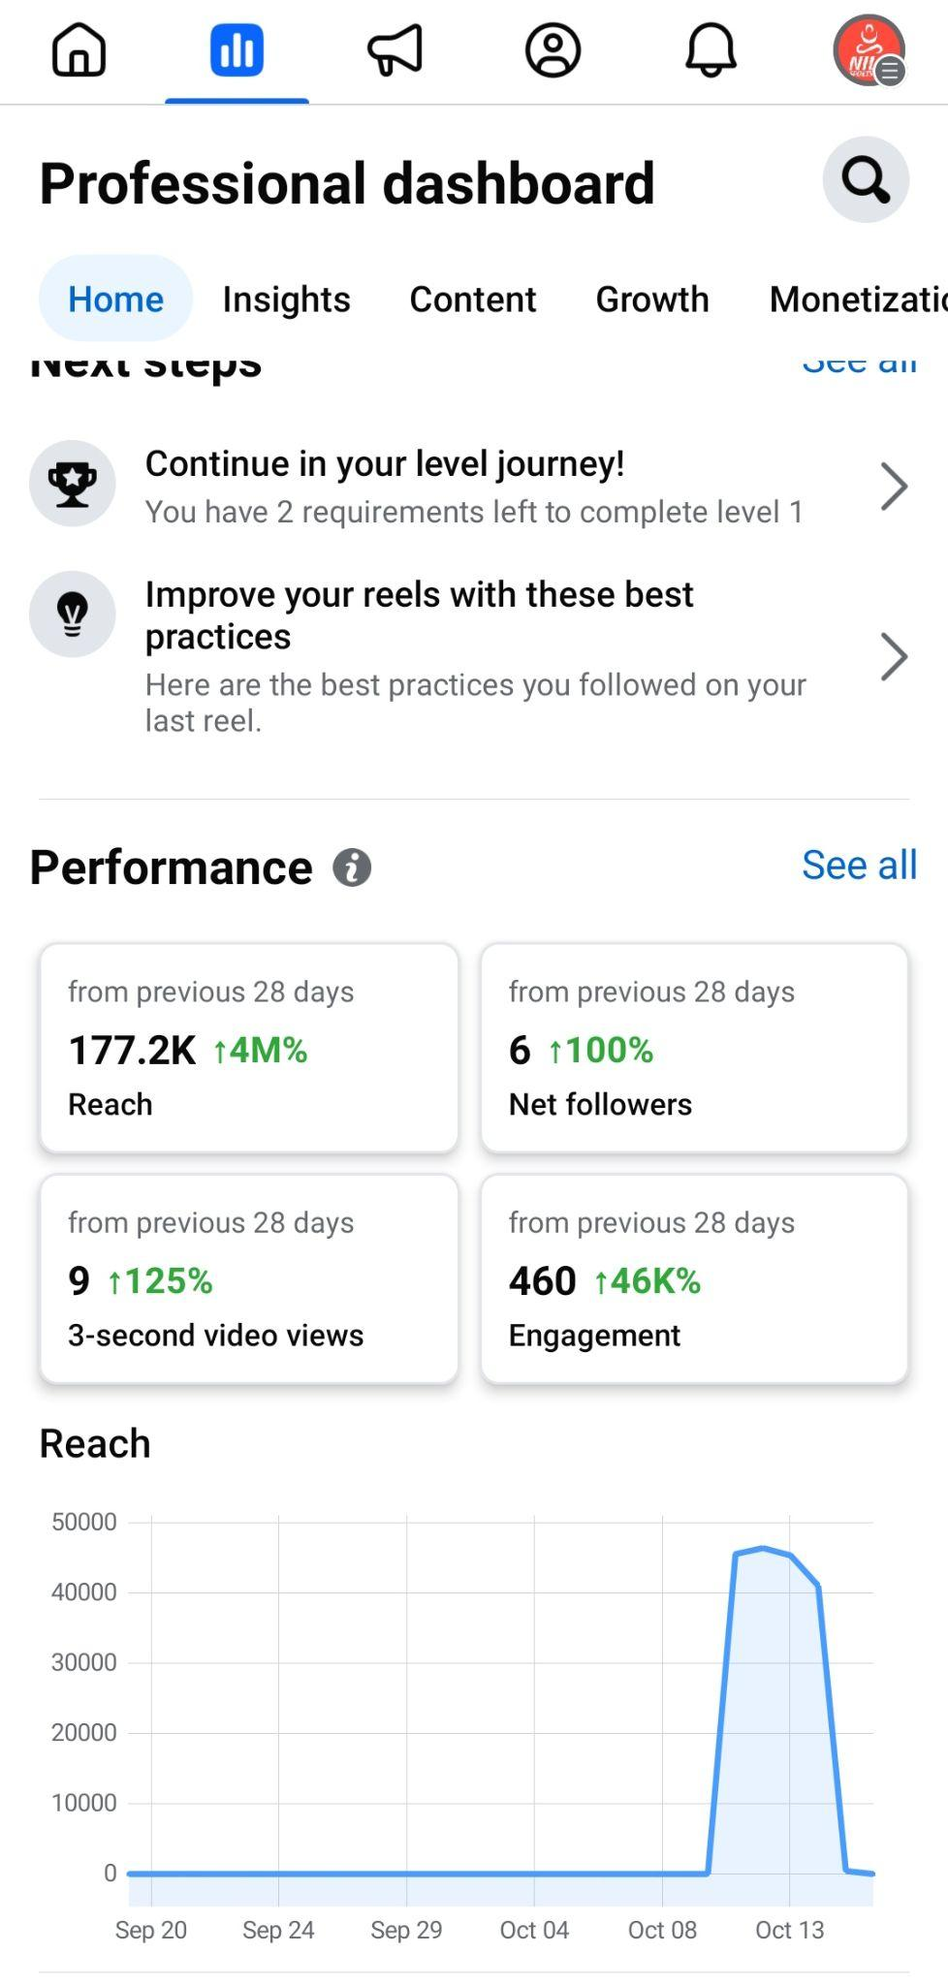
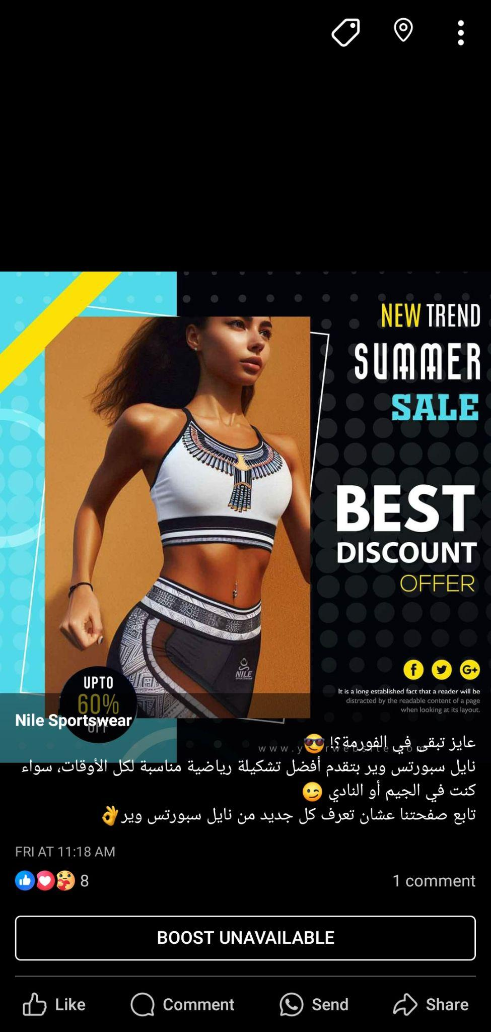
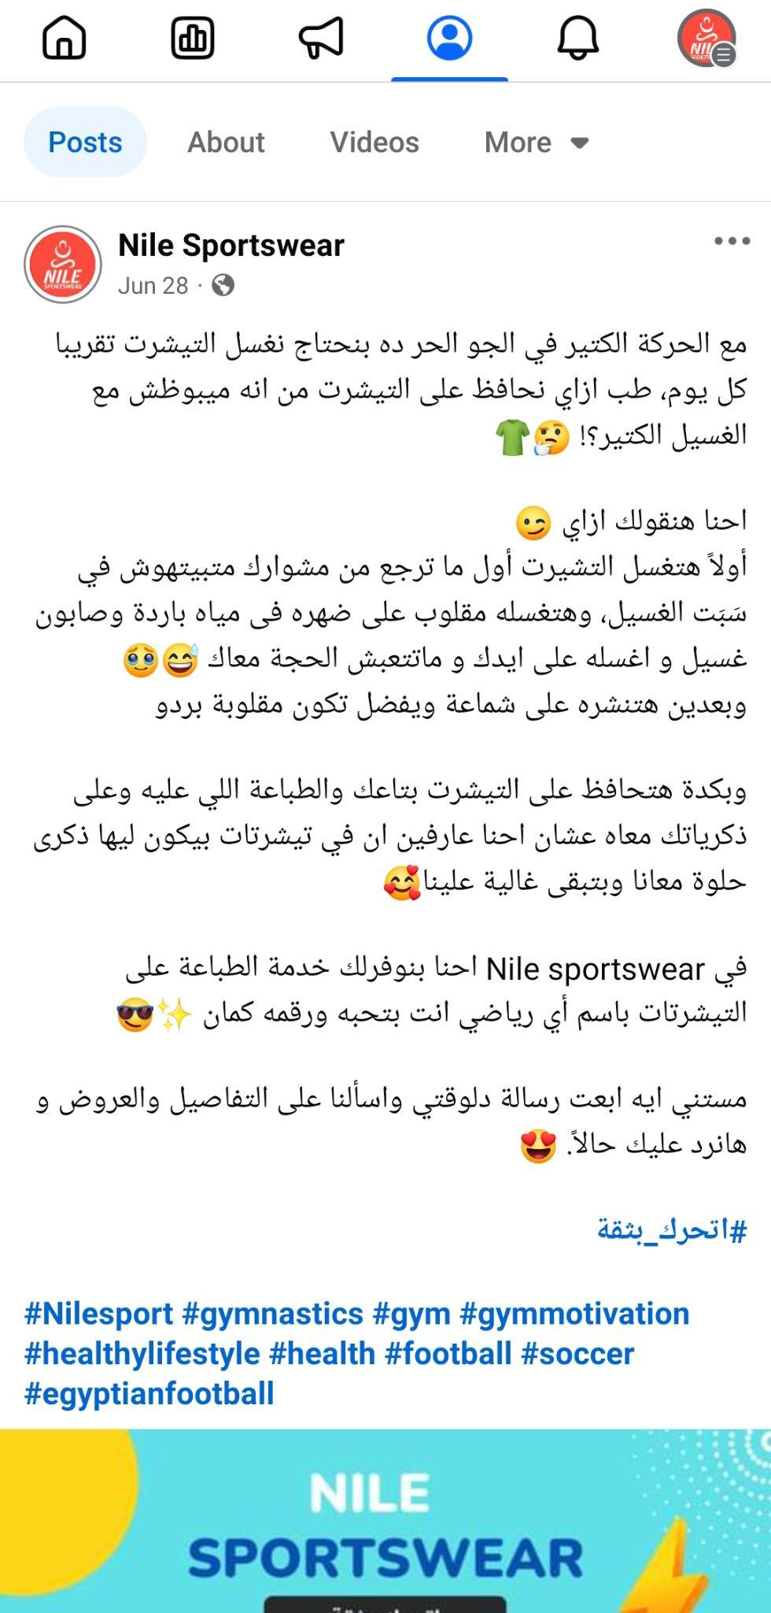
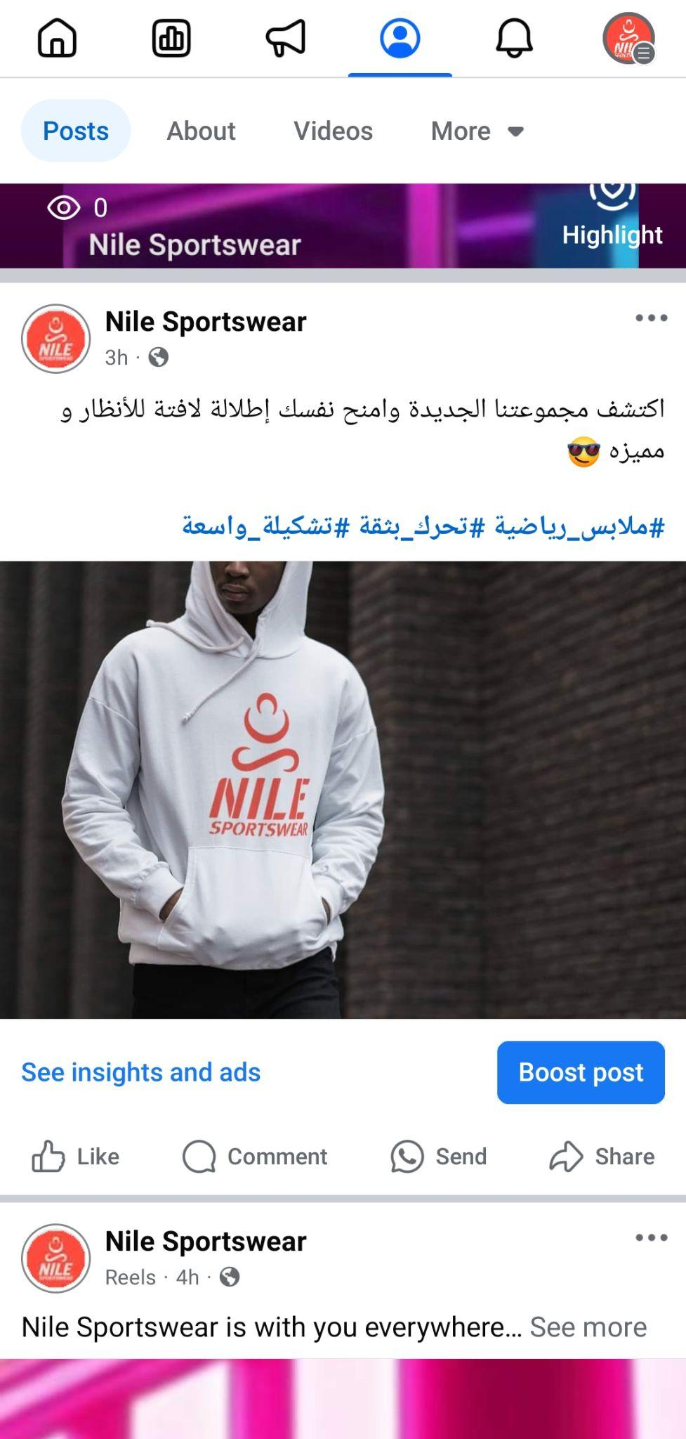
Action: Facebook Ad & Posts

Slide 26
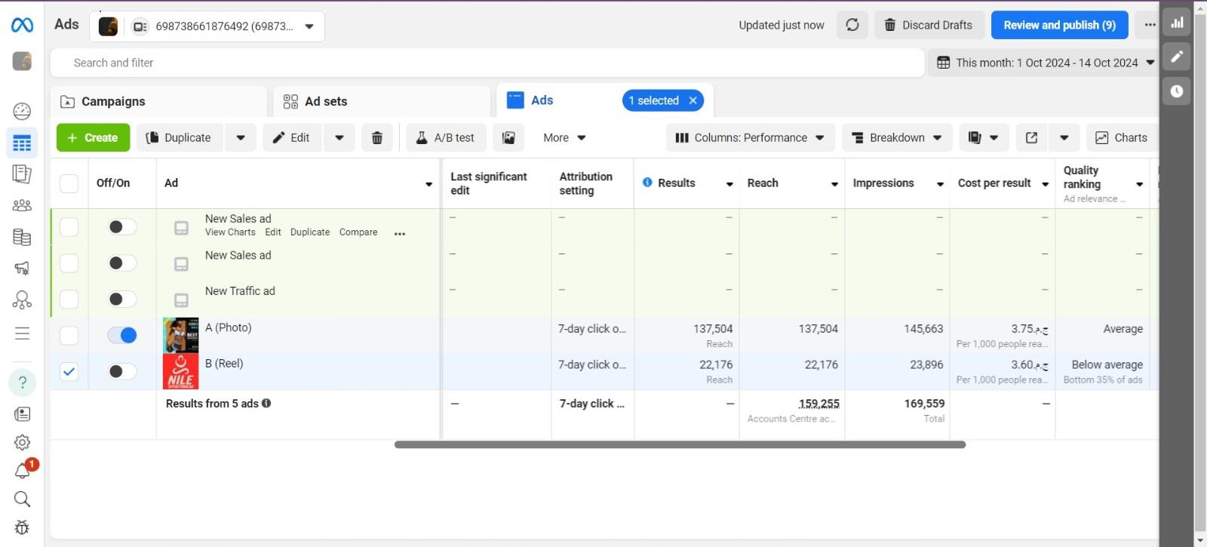
Action: Facebook Ad & Post

Slide 27
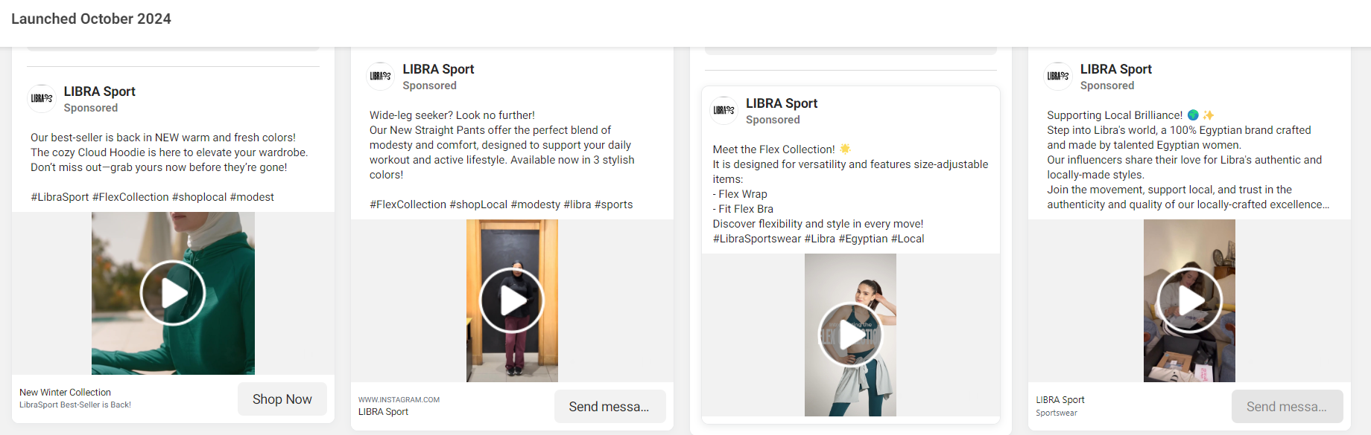
Action: Competitors Ads

Slide 28
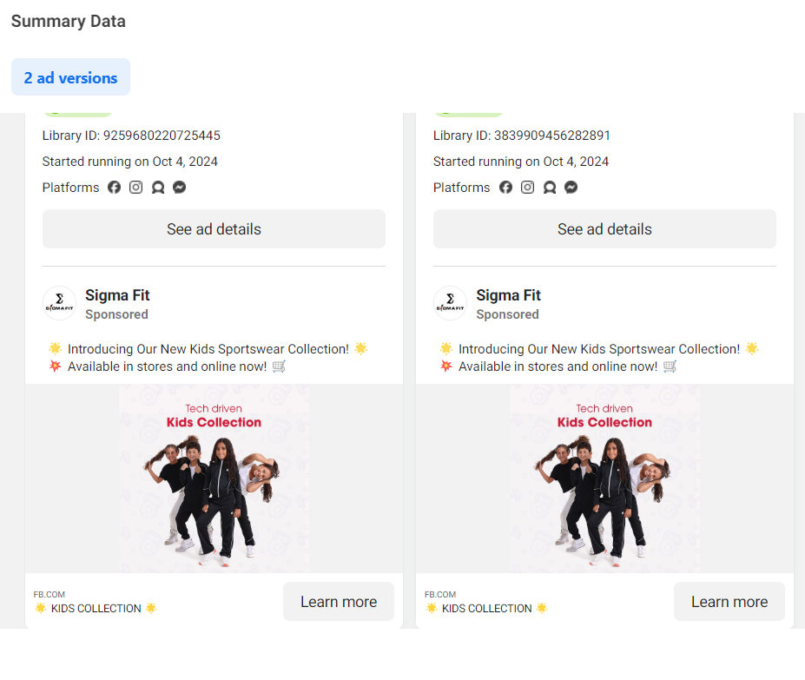
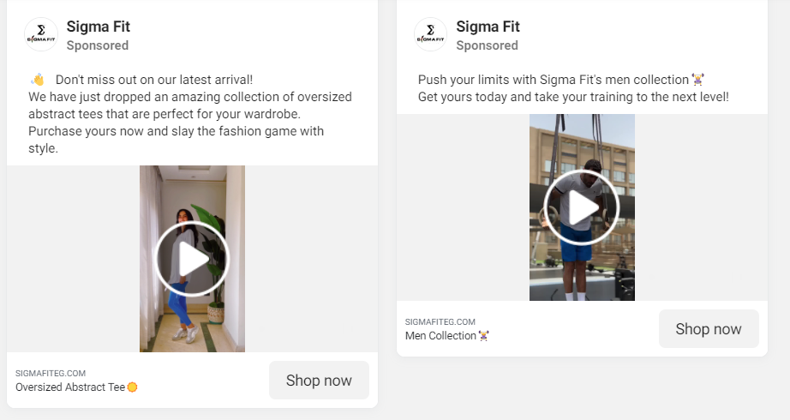
Action: Competitors Ads

Slide 29
KPIs
Here are some Key Performance Indicators (KPIs) for Nile Sportswear, categorized based on different business objectives:
Brand awareness
01
Social Media Followers
Target: Reach 1,000 followers/subscribers in the first month and 5,000 followers/subscribers by the fourth month across platforms (Facebook, Instagram, TikTok).
02
Social Media Engagement Rate
Measure likes, comments, shares, and interactions on posts. Aim for a 5% engagement rate per post.
03
Impression and reach
Track the total number of times content is seen (impressions) and the number of unique viewers (reach) across platforms.
04
Website traffic
Monitor the number of visitors to the website, aiming for steady monthly growth (e.g., a 10% increase in visitors per month)
05
SEO Ranking
Track the ranking of Nile Sportswear’s website for key search terms (e.g., "Egyptian sportswear," "affordable sportswear"). Aim to rank in the top 5 positions for key terms within the first 6 months.

Slide 30
Recommendations and Improvements:
1. Improve Digital Presence
Mobile App Development: Create a mobile app for seamless shopping experiences, push notifications for exclusive deals, and personalized shopping features based on user preferences.
2. Strengthen Customer Engagement
User-Generated Content (UGC): Encourage customers to share photos and reviews of themselves wearing Nile Sportswear. This can be showcased on social media and the website, building trust and authenticity.

Slide 31
Recommendations and Improvements:
3. Enhance Social Media Strategy
Focus on creating more interactive content such as polls, Q&A sessions, fitness challenges, and live workout sessions.
Launch giveaways and social media contests to build excitement and drive engagement. For example, offer a chance to win a full sportswear kit for those who tag friends or share workout content using a specific hashtag.
4. Expand Marketing Channels
Utilize Google Ads and YouTube Ads in addition to social media advertising to target fitness enthusiasts and people looking for workout gear.
Invest in content marketing through blog posts, fitness guides, and video tutorials that provide value to potential customers and drive organic traffic to the website.

Slide 32
Thank you
o
T

